Slide 1
Software Engineering
Lecture 9

Slide 2
Agenda
Use Case Diagram

Slide 3
Introduction
Use-cases are descriptions of the functionality of a system from a user perspective.
Depict the behavior of the system, as it appears to an outside user.
Describe the functionality and users (actors) of the system.
Show the relationships between the actors that use the system, the use cases (functionality) they use, and the relationship between different use cases.
Document the scope of the system.
Illustrate the developer’s understanding of the user’s requirements.

Slide 4
Purpose
Use case models are developed at different levels of abstraction.
system, system component, or a class.
Use case modelling is an iterative and incremental process.
If user requirements change, the changes should be made in all the affected documents. Requirement's document (text in natural language) Class diagrams Activity diagrams Sequence diagrams State chart diagrams

Slide 5
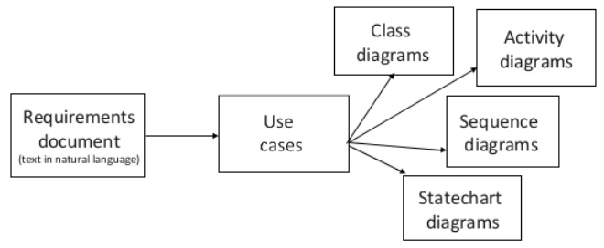
Purpose

Slide 6
Basic UML Notation
Use Case: A Use Case is a description of a set of interactions between a user and the system.
Components of use case diagram:
Actor
Use case
System boundary
Relationships
Actor Roles
Use case description

Slide 7
Information a Use-case captures
Actors
Relationships with other use cases
Pre-conditions
Details
Post-conditions
Exceptions
Constraints
Alternatives

Slide 8
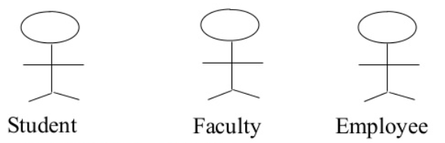
Actors
An actor is some one or something that must interact with the system under development.
Actors can be human or automated systems.
Actors are not part of the system.
UML notation for actor is stickman, shown below.

Slide 9
Actors
It is role a user plays with respect to system.
Actors carry out use cases and a single actor may perform more than one use cases.
Actors are determined by observing the direct uses of the system.

Slide 10
Primary and Secondary Actors
Primary Actor
Acts on the system
Initiates an interaction with the system
Uses the system to fulfill his/her goal
Events Something, we don’t have control over
Secondary Actor
Is acted on/invoked/used by the system
Helps the system to fulfills its goal
Something the system uses to get its job done

Slide 11
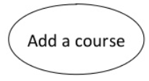
Use-Case
What is Use-Case?
A use case is a pattern of behavior, the system exhibits.
The use cases are sequence of actions that the user takes on a system to get particular target.
Use Case is dialogue between an actor and the system.

Slide 12
Contd..
A use case typically represents a major piece of functionality that is complete from beginning to end.
Most of the use cases are generated in initial phase but may add some more after proceeding.
A use case may be small or large. It captures a broad view of a primary functionality of the system in a manner that can be easily grasped by nontechnical user.

Slide 13
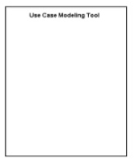
System Boundary
It is shown as a rectangle.
It helps to identify what is external versus internal, and what the responsibilities of the system are.
The external environment is represented only by actors.

Slide 14
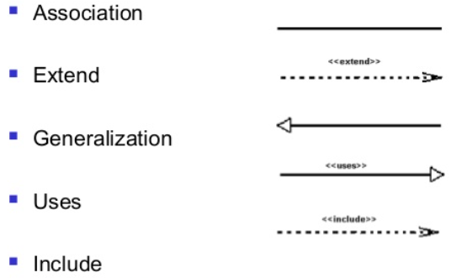
Relationship
Relationship is an association between use case and actor.
There are several Use Case relationships:

Slide 15
Extend Relationship
The extended relationship is used to indicate that use case completely consists of the behavior of another use case at one or specific point
use cases that extend the behavior of other core use cases. Enable to factor variants
The base use case implicitly incorporates the behavior of another use case at certain points called extension points
It is shown as a dotted line with an arrow point and labeled <<extend

Slide 16

Extend Relationship

Slide 17
Generalization
Generalization is a relationship between a general use case and a more specific use case that inherits and extends features to it
Use cases that are specialized versions of other use cases
It is shown as a solid line with a hollow arrow point

Slide 18
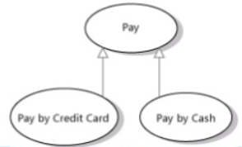
Generalization

Slide 19
Uses Relationship
When a use case uses another process, the relationship can be shown with the uses relationship
This is shown as a solid line with a hollow arrow point and the <<uses>> keyword

Slide 20
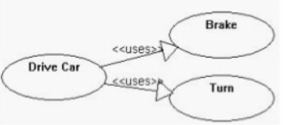
Uses Relationship

Slide 21
Include Relationship
Include relationships insert additional behavior into a base use case
Use cases that are included as parts of other use cases. Enable to factor common behavior.
The base use case explicitly incorporates the behavior of another use case at a location specified in the base.
They are shown as a dotted line with an open arrow and the key word <<include>>

Slide 22
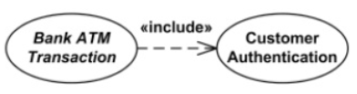
Include Relationship

Slide 23
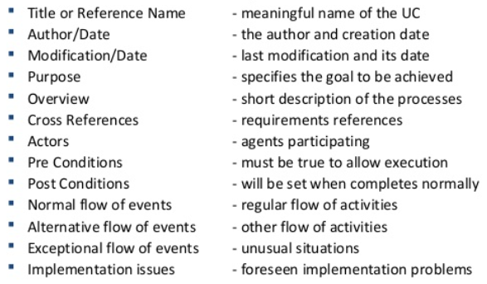
Use Case Description
Each use case may include all or part of the following:

Slide 24
Example - Money Withdraw
Use Case: Withdraw Money
Author: XYZ
Date: 04-06-2021
Purpose: To withdraw some cash from user’s bank account
Overview: The use case starts when the customer inserts his card into the system. The system requests the user PIN. The system validates the PIN. If the validation succeeded, the customer could choose the withdraw operation else alternative 1 – validation failure is executed. The customer enters the amount of cash to withdraw. The system checks the amount of cash in the user account, its credit limit. If the withdraw amount in the range between the current amount + credit limit the system dispense the cash and prints a withdraw receipt, else alternative 2 – amount exceeded is executed.
Cross References: R1.1, R1.2, R7

Slide 25
Example - Money Withdraw
Actors: Customer
Pre-Condition
The ATM must be in a state ready to accept transactions
The ATM must have at least some cash on hand that it can dispense
The ATM must have enough paper to print a receipt for at least one transaction
Post Condition
The current amount of cash in the user account is the amount before the withdraw minus the withdraw amount
A receipt was printed on the withdraw amount
The withdraw transaction was audit in the System log file

Slide 26
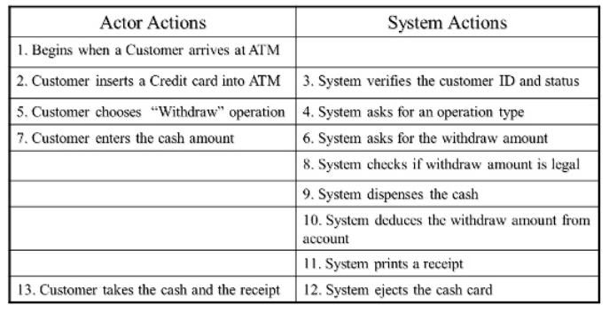
Typical course of events

Slide 27
Alternative flow of events:
Step 3: Customer authorization failed. Display an error message, cancel the transaction and eject the card. – Step 8: Customer has insufficient funds in its account. Display an error message and go to step 6.
Step 8: Customer exceeds its legal amount. Display an error message and go to step 6.
Exceptional flow of events:
Power failure in the process of the transaction before step 9, cancel the transaction and eject the card

